Slide 1
DATA MARTS

Slide 2
What Is a Data Mart?
A data mart is a simple form of a data warehouse that is focused on a single subject (or functional area), such as Sales, Finance, or Marketing.
Data marts are often built and controlled by a single department within an organization.
Given their single-subject focus, data marts usually draw data from only a few sources.
The sources could be internal operational systems, a central data warehouse, or external data.

Slide 3
How Is It Different from a Data Warehouse?
A data warehouse, unlike a data mart, deals with multiple subject areas.
DW is typically implemented and controlled by a central organizational unit such as the corporate Information Technology (IT) group.
Typically, a data warehouse assembles data from multiple source systems.
Data marts are typically smaller and less complex than data warehouses; hence, they are typically easier to build and maintain.

Slide 4
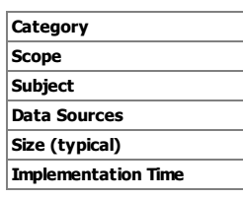
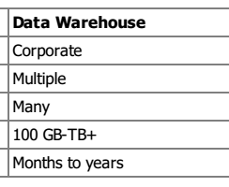
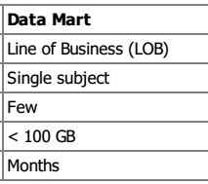
How Is It Different from a Data Warehouse?

Slide 5
Advantages of data mart
The primary purpose of a data mart can be summarized as follows:
Provides fast access to information for specific analytical needs
Controls end user access to the information
Represents the end user view and data interface to the data warehouse
Creates a multi-dimensional view of data for enhanced analysis
Offers multiple slice-and-dice capabilities for detailed data analysis
Stores pre-aggregated information for faster response times

Slide 6
Types of data marts
Basically, there are two types of data marts:
Dependent: These data marts contain data that has been directly extracted from the data warehouse. Therefore, the data is integrated, and is consistent with the data in the data warehouse.
Independent: These data marts are stand-alone, and are populated with data from outside the data warehouse. Therefore, the data is not integrated, and is not consistent with the data warehouse.

Slide 7
The main difference between independent and dependent data marts is how you populate the data mart; that is, how you get data out of the sources and into the data mart. This step, called the Extraction-Transformation-and Loading (ETL) process, involves moving data from operational systems, filtering it, and loading it into the data mart.
The ETL process for dependent data marts is mostly a process of identifying the right subset of data relevant to the chosen data mart subject and moving a copy of it, perhaps in a summarized form.

Slide 8
With independent data marts, however, you must deal with all aspects of the ETL process, much as you do with a central data warehouse. The number of sources is likely to be fewer and the amount of data associated with the data mart is less than the warehouse, given your focus on a single subject.
Dependent data marts are usually built to achieve improved performance and availability, better control, and lower telecommunication costs resulting from local access of data relevant to a specific department. The creation of independent data marts is often driven by the need to have a solution within a shorter time.

Slide 9
Metadata for a data mart
Metadata( data about data) describes the details about the data in a data warehouse or in a data mart.
Such a information may be in terms of the contents and source of data that flows into the data warehouse or data mart.
Following are the components of meta data for a given data warehouse and data mart:
Description of sources of the data.
Description of customization that may have taken place as per
the data passes from data warehouse into data mart.

Slide 10
Metadata for a data mart
Descriptive information about data mart.
Definitions of all types.
The metadata of a data mart is created and updated from the load program that move data from data warehouse to data mart.
The linkages and relationships between metadata of a data warehouse and metadata of data mart have to be well established or well understood by managers or analysts using the metadata.

Slide 11
Metadata for a data mart
Metadata can be classified into:
Technical Metadata
Business Metadata
Technical Metadata: Which contains information about warehouse data for warehouse designer and administrator When carrying out warehouse managing and development tasks.
Technical metadata document includes:
Information about data sources
Transformation descriptions i.e. mapping from operational database to data warehouse.

Slide 12
Rules used to perform data cleanup and data enhancement.
Access authorization, Backup history, information delivery history, data access etc.
Business Metadata: Contains information that gives users an easy to understand the perspective of the information stored in data warehouse.
Business metadata documents contains information about:
Subject area and information object type including queries, reports, images, videos etc.

Slide 13
Data model for data mart
A formal data model is required to be built for a large data mart which may also have some processing involved.
No data model is necessary for ordinary or simple small data marts with no processing.
Such a data model should be compatible with the DBMS which handles the data mart.
Data marts which can be modeled in terms of formal data model which will take care of both detailed and summary level of data in the particular context of the application for the given department.

Slide 14
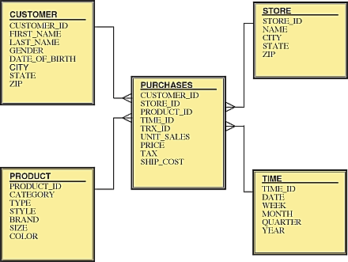

Slide 15
Maintenance of data mart
Periodic maintenance of a data mart means loading, refreshing and purging ( removing an unwanted or undesirable data) the data in it.
Refreshing the data is performed in regular cycles as per the nature of the frequency of data update.
For example, Share market data on immediate basis, census data may be refreshed on yearly basis, bank transactional data may be refreshed on daily basis etc.
The refreshing may be daily, weekly, monthly, quarterly, yearly depending on the nature of the particular nature and frequency of the data.

Slide 16
Maintenance of data mart
As regards to purging of data in a data mart, the data mart is read periodically and some old data is selected for purging and removing.
The criteria for purging depends on date, time and periodicity based on any criterion decided by the application requirements.

Slide 17
Nature of data in data mart
The data in a data mart can be of detailed level, summary level, ad hoc data, preprocessed or prepared data.

Slide 18
Software components for a data mart
The software that can be found with a data mart includes:
DBMS,
Access and analysis software,
software for automatic creation of data mart,
purging and archival software and
metadata management software etc.
The software also performs elegant or impressive presentation of the data so derived to the user.

Slide 19
Tables in data mart
A data mart may include :-
summary tables,
detailed tables,
reference tables,
historical tables,
analytical( spreadsheet) tables etc.
As the data grows, the backlog back-up may be kept as a library, which can also serve the purpose of a quick reference for a survey of available data as and when required.

Slide 20
Tables in data mart
The data is kept in tables in the form of star joins on normalized tables.
Star joins are required to be created when a predictable pattern of usage is required on a significant amount of data.
Otherwise when the data is not large, relational tables are adequate.

